Slide 1
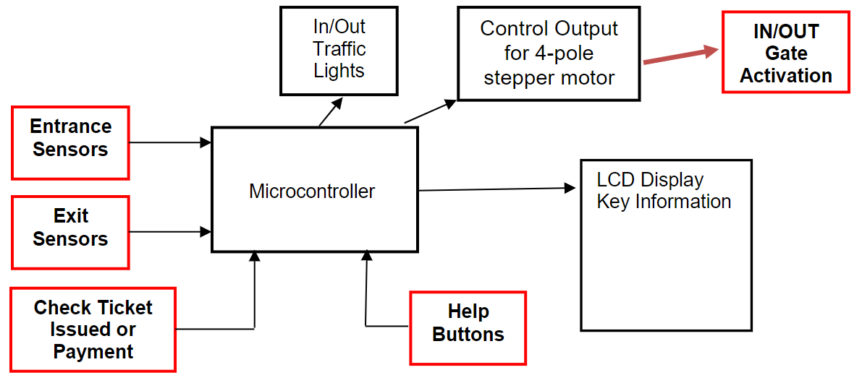
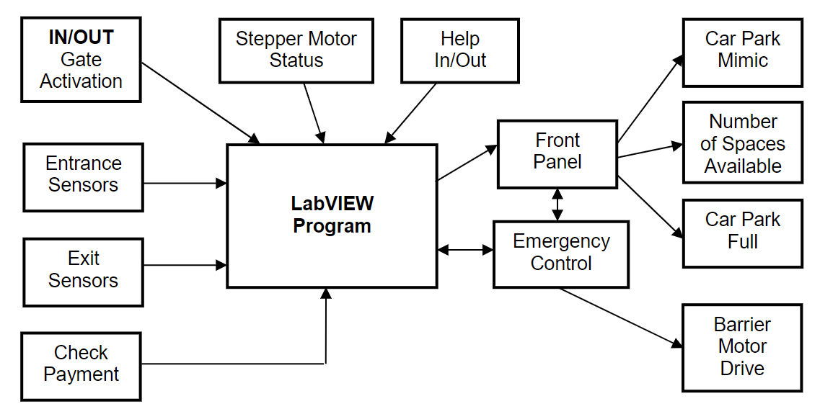

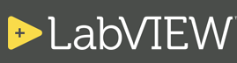
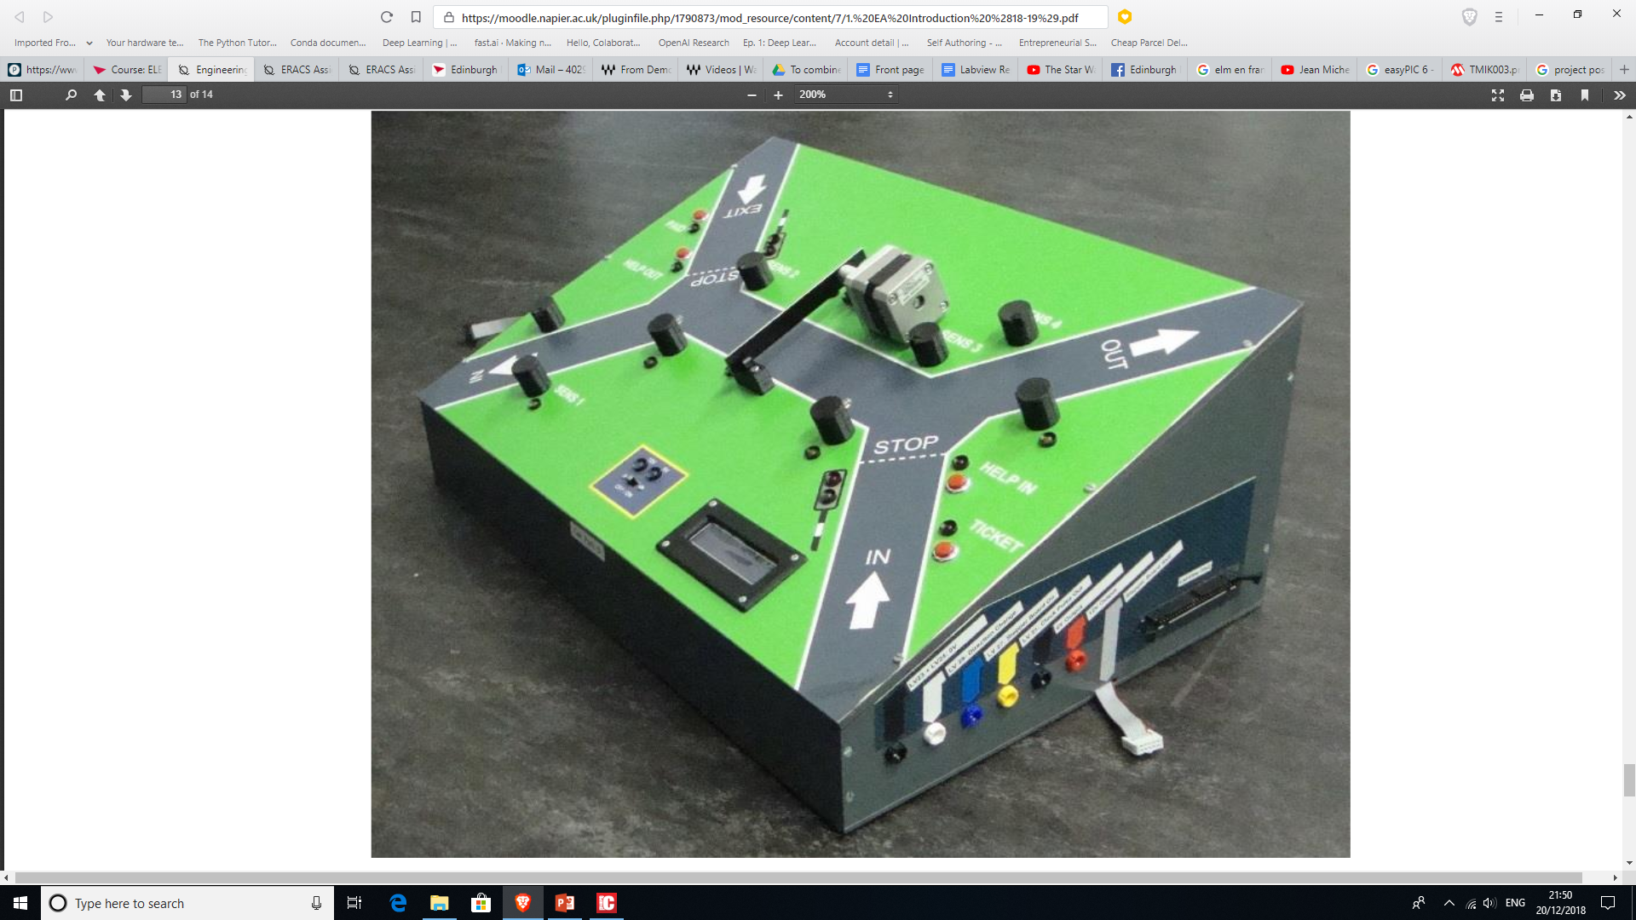
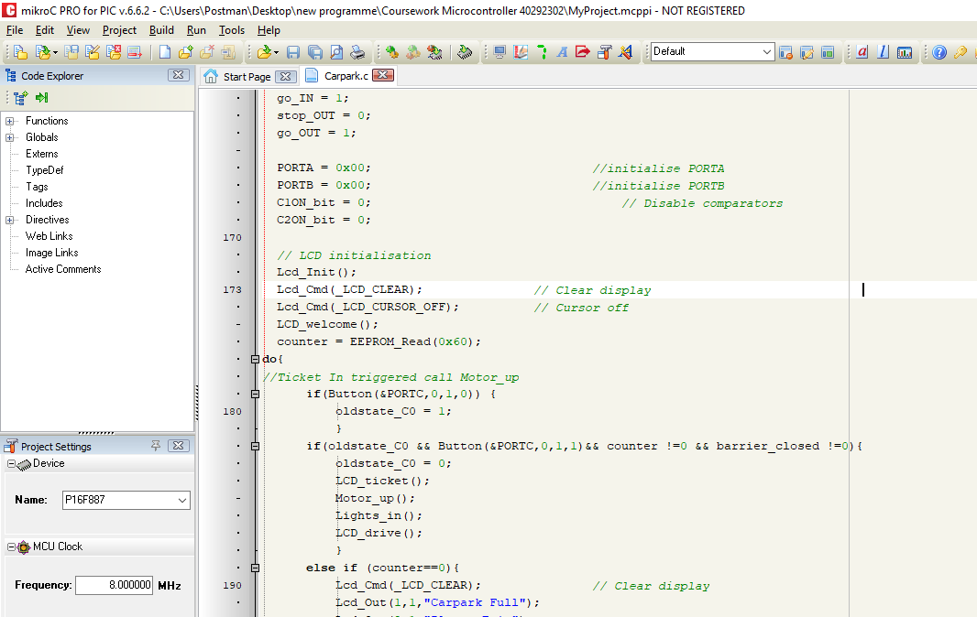
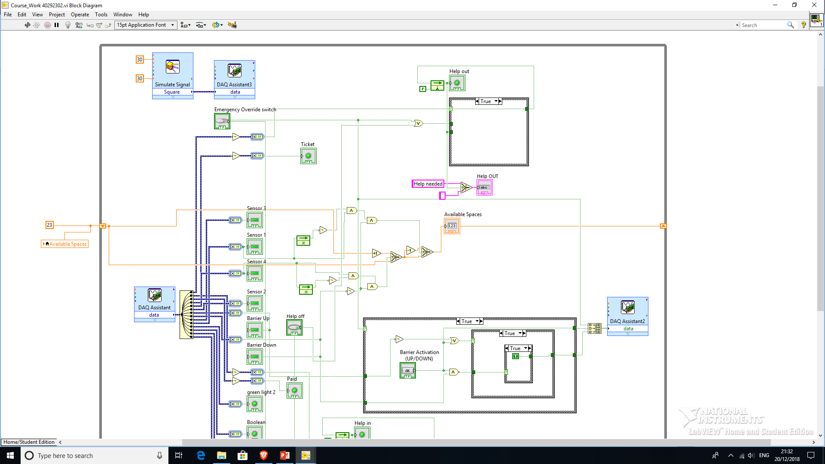
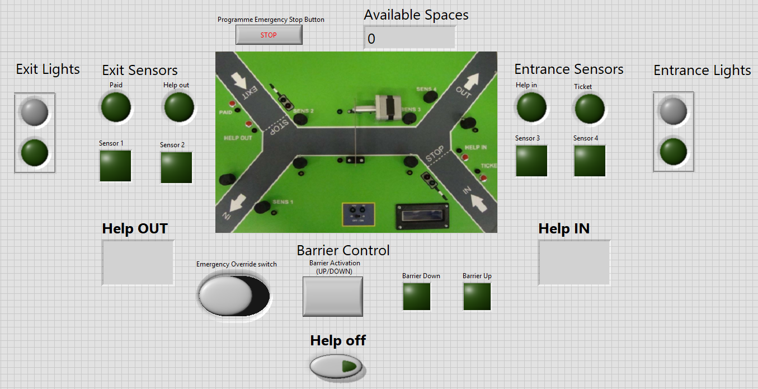
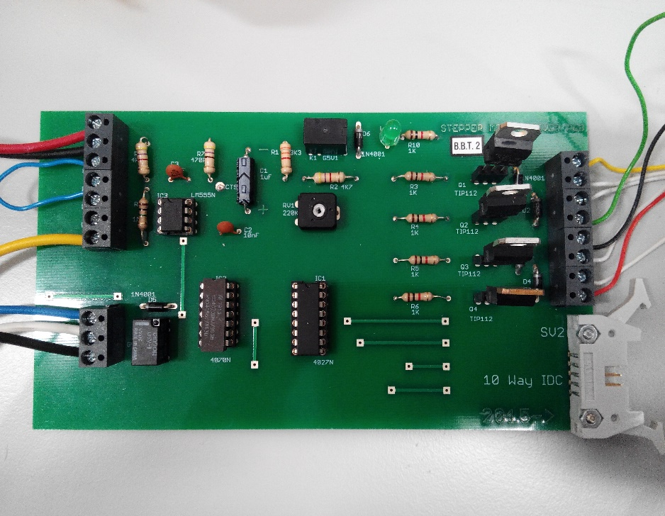
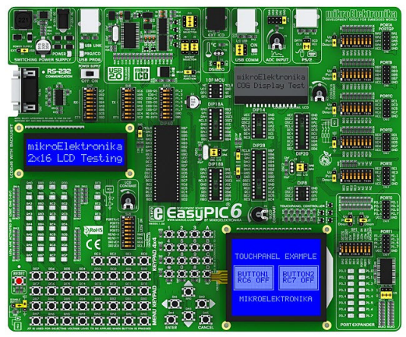
Car Park Control and Monitoring System: Embedded System and Virtual Control / Monitoring Room Design.
Main Objectives of the Project:
Design, test and simulate an embedded system to automatically control the Car Park.
Programme the embedded system using the language C. The applications needs to be functional and logical.
Design, build and test a virtual control panel to enable an operator to override the microcontroller system. It should allow the operator to raise and lower the barrier.
The car park control and monitoring system will be demonstrated to the clients.
Embedded System using EasyPIC6 and mikroC PRO for PIC:
Using programming language C. The syntax is very important.
The programme is a blend of modular and sequential functions.
Attention was taken to keep the system logical and functional.
The programme was loaded onto the EasyPIC and then connected through PORT A,B,C and D to the car park for test.
Virtual Control and Monitoring room with LabVIEW:
Realisation of a Drive Control PCB to control the barrier motor.
A data acquisition card inputs and outputs signals from the virtual room on the PC to the car park.
An operator control panel was realised to allow override of the microcontroller programme and operate the barrier “manually”.
The control panel offers displays allowing to monitor the car park (Switches pressed, car spaces available, position monitoring sensors…).
Module ELE09104 Electrical and Electronic - Engineering Applications. Olivier Chaligné – 40292302. 15/12/2018.

